Slide 1

DETECTION OF ALZHEIMER’S DISEASE USING MAGNETIC RESONANCE IMAGES BASED ON MACHINE LEARNING METHOD
Project Team Members :
19891A0581-G.SAI VARSHITH
19891A05B5-T.CHANDRA SHEKAR RAO
19891A05B3-S.V.SISIR KOUSTHUB
Under the Guidance of:
Dr.Ch.RAJA RAMESH
Associate Professor

Slide 2
ABSTRACT
Alzheimer's disease is an unrepairable degenerative brain disease. Every four seconds, someone in the world is diagnosed with Alzheimer's disease. It is a neurodegenerative disorder that affects elderly people. The leading cause of dementia is Alzheimer's disease. Dementia causes a reduction in reasoning abilities and interpersonal coping skills, which affects people's ability to function independently. The patient will forget recent events in theearly stages. If the illness progresses, they will gradually forget whole events. This is a progressive disease and early detection and classification of AD can majorly help incontrolling the disease. Recent studies use voxel-based brain MR image feature extraction techniques along with machine learning algorithms for this purpose. Grey and white matter of the brain gets affected and damaged due to AD and so studying these both prove to be more effective in predicting the disease. It's crucial to catch the disease early on. This project proposes a model that takes brain MRI sample images as input and determines whether aperson has Alzheimer's disease or not as an output. We are using machine learning algorithms to predict the disease accurately.

Slide 3
INTRODUCTION
Alzheimer's disease (AD) is the leading cause of dementia in older adults.
In Alzheimer's disease, the brain is affected by neurodegenerative changes.
As our aging population increases, more and more individuals, their families, and healthcare will experience diseases that affect memory and functioning. These effects will be profound on the social, financial, and economic fronts.
In its early stages, Alzheimer's disease is hard to predict.A treatment given at an early stage of AD is more effective, and it causes fewer minor damage than a treatment done at a later stage.

Slide 4
EXISTING SYSTEM
Over the years, several researchers have used different approaches to diagnose Alzheimer's Disease. All researchers of this domain focus on monitoring a patient's health change, clinical progression of disease, and reaction to the therapy. It is most challenging for them to find relevant bio-markers that represent AD and MCI well.Their goal is not only to diagnose this disease at an early stage, but also identify which people are most likely to develop AD. Magnetic Resonance Imaging (MRI) is a non_x0002_invasive medical tool that physicians use to diagnose patient disease or health conditions.

Slide 5
The MRI techniques generally include a powerful magnetic field, radiofrequency pulses, and a computer to produce detailed pictures of all internal body structures.
Individual or combined structural MRI biomarkers such as shape and texture of the hippocampus, cortical measurements, and volume measurements are used as biomarkers for the multiclass classification of AD, mild cognitive impairment (MCI).

Slide 6
PROPOSED SYSTEM
In proposed system we come with a deep learning techniques.
Deep Learning is known to be learning a hierarchical set of representations such that it learns low mid and high-level features.
Deep neural networks can adapt to more complex data sets.
Different algorithms use Deep Learning's fundamental expertise and use diverse datasets to train and test these algorithms.

Slide 7
Like neurons in humans, deep learning has layers that help the model or algorithm learn and process the data.
These layers process the data given to them as the input and learn by processing the input while travelling through the layers.
When it passes out the last layer, an activation function is applied at last, and finally, we get the predicted output from the deep learning model.
This gives us the training accuracy, and then when we take another similar type of dataset, we can predict or detect from the learned deep learning model whatsoever we want.

Slide 8
SOFTWARE AND HARDWARE REQUIREMENTS
SOFTWARE REQUIREMENTS
OS: Windows/Mac/Linux
Platforms: Anaconda/Jupyter Notebook,Google Colab
Software: Python 3.7
Packages: pandas, seaborn, matplotlib, NumPy, TensorFlow, keras
HARDWARE REQUIREMENTS
RAM: 4GB
Processor: Intel I5 octa-core (1.5GHz - 2.6GHz)
Secondary Storage: 256GB
Graphics card: 1650 or 1660TI

Slide 9
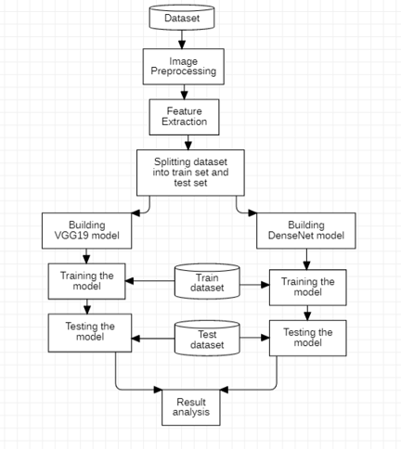
SYSTEM ARCHITECTURE

Slide 10
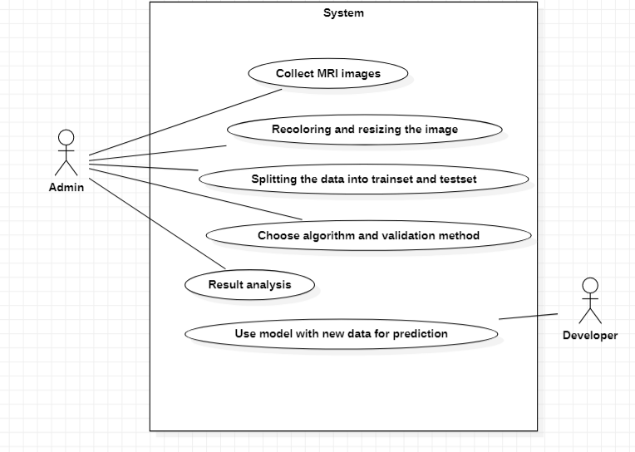
SYSTEM DESIGN: Use Case Diagram:

Slide 11
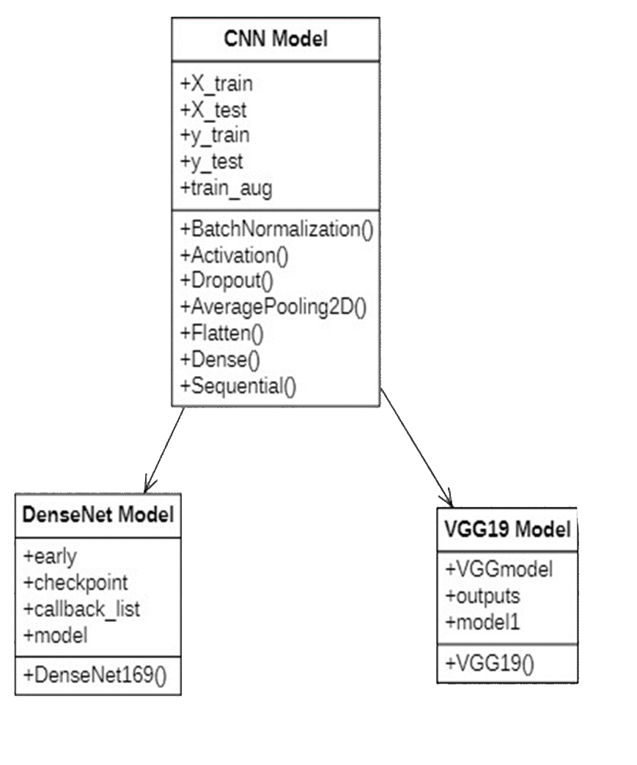
Class Diagram:

Slide 12
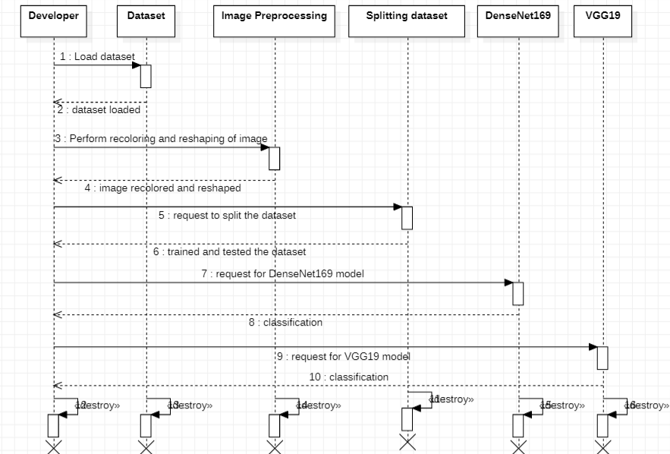
Sequence Diagram:

Slide 13
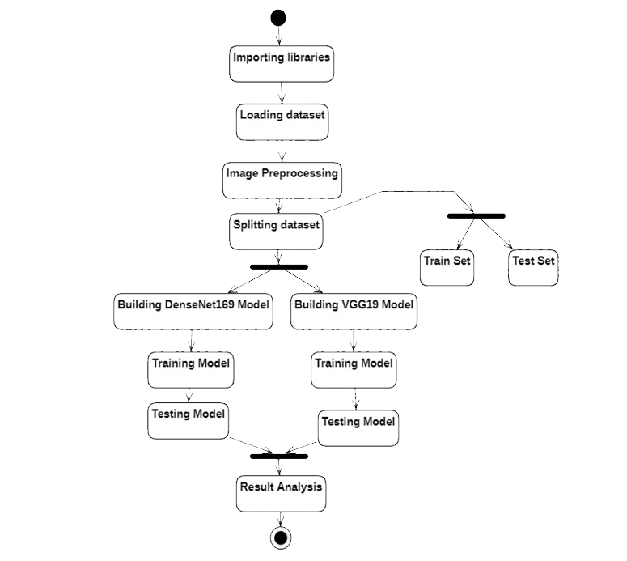
Activity Diagram:

Slide 14
SYSTEM IMPLEMENTATION: Modules:
Image Processing :
Image processing is the process of transforming an image into a digital form and performing certain operations to get some useful information from it. The image processing system usually treats all images as 2D signals when applying certain predetermined signal processing methods.
Data collection:
Data collection is the transportation of data from assorted sources to a storage medium where it can be accessed, used, and analysed by an organization. The destination is typically a data warehouse, data mart, database, or a document store. Sources may be almost anything – including SaaS data, in-house apps, databases, spreadsheets, or even information scraped from the internet. The data ingestion layer is the backbone of any analytics architecture. Downstream reporting and analytics systems rely on consistent and accessible data. There are different ways of ingesting data, and the design of a particular data ingestion layer can be based on various models or architectures.

Slide 15
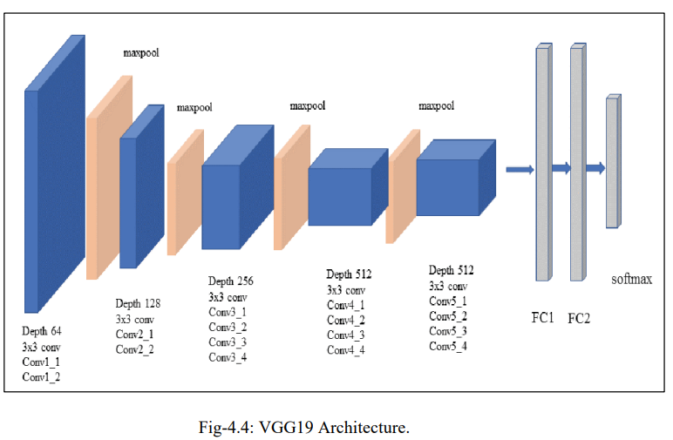
Algorithms:
1. VGG19 :

Slide 16
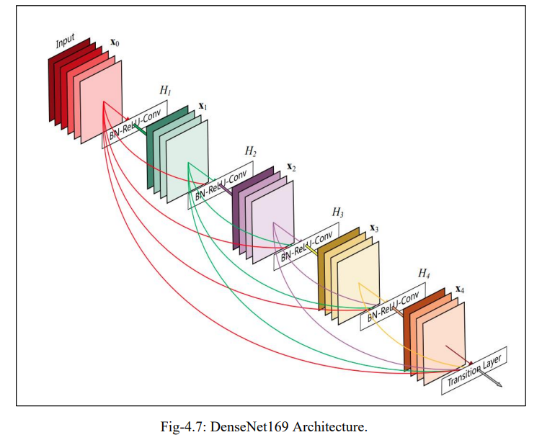
2.DenseNET169

Slide 17
Algorithm Description: 1. VGG19 :
VGG19 is a variant of VGG model which in short consists of 19 layers (16 convolution layers, 3 Fully connected layer, 5 MaxPool layers and 1 SoftMax layer).
Convolution layer:
Convolutional layers in a convolutional neural network systematically apply learned filters to input images in order to create feature maps that summarize the presence of those features in the input. Convolutional layers prove very effective, and stacking convolutional layers in deep models allows layers close to the input to learn low-level features (e.g., lines) and layers deeper in the model to learn high-order or more abstract features, like shapes or specific objects.

Slide 18
MaxPool layer: The addition of a pooling layer after the convolutional layer is a common pattern used for ordering layers within a convolutional neural network that may be repeated one or more times in a given model. The pooling layer operates upon each feature map separately to create a new set of the same number of pooled feature maps. Pooling involves selecting a pooling operation, much like a filter to be applied to feature maps. The size of the pooling operation or filter is smaller than the size of the feature map; specifically, it is almost always 2×2 pixels applied with a stride of 2 pixels. This means that the pooling layer will always reduce the size of each feature map by a factor of 2, e.g., each dimension is halved, reducing the number of pixels or values in each feature map to one quarter the size.
Fully Connected Layer :
Fully Connected Layer is simply, feed forward neural networks. Fully Connected Layers form the last few layers in the network. The input to the fully connected layer is the output from the final Pooling or Convolutional Layer, which is flattened and then fed into the fully connected layer.

Slide 19
2.DenseNET169
Convolutional neural networks are popular for image processing because of a number of technical advantages compared to fully connected neural networks or other architectures. CNNs are composed of convolution layers followed by subsampling layers. The convolution layer allows detecting features (or patterns) in the image, such as edges. In addition, a subsampling layer (such as avg pooling, max pooling, down_x0002_sampling, up-sampling) allows the resolution to be reduced at the position of the patterns. In the end, we are not concerned with the exact location of the patterns in the image but with their relationship to other patterns [12].

Slide 20
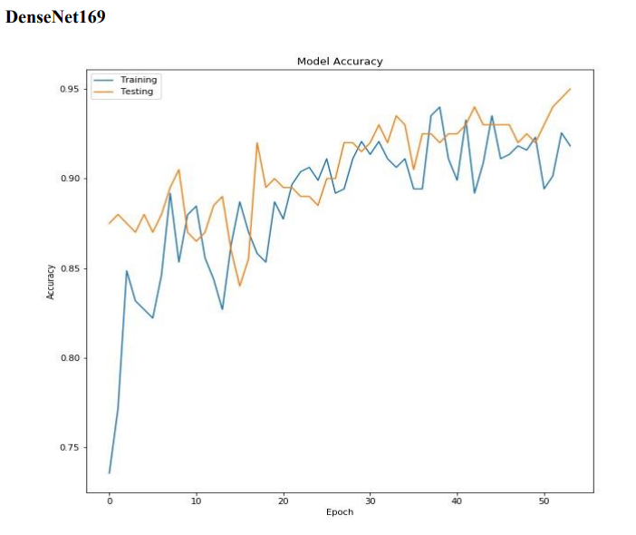
Result :

Slide 21
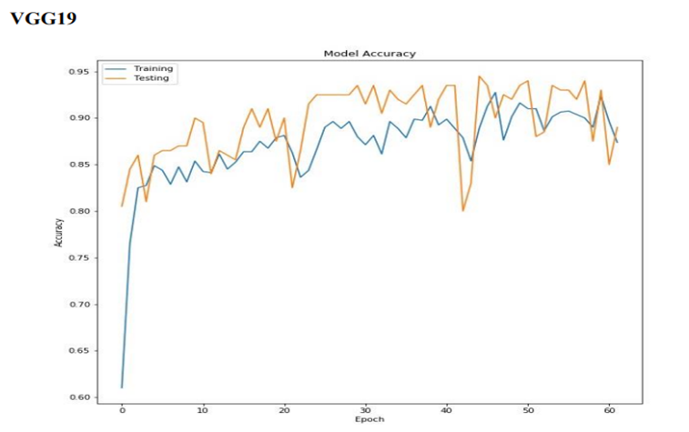

Slide 22
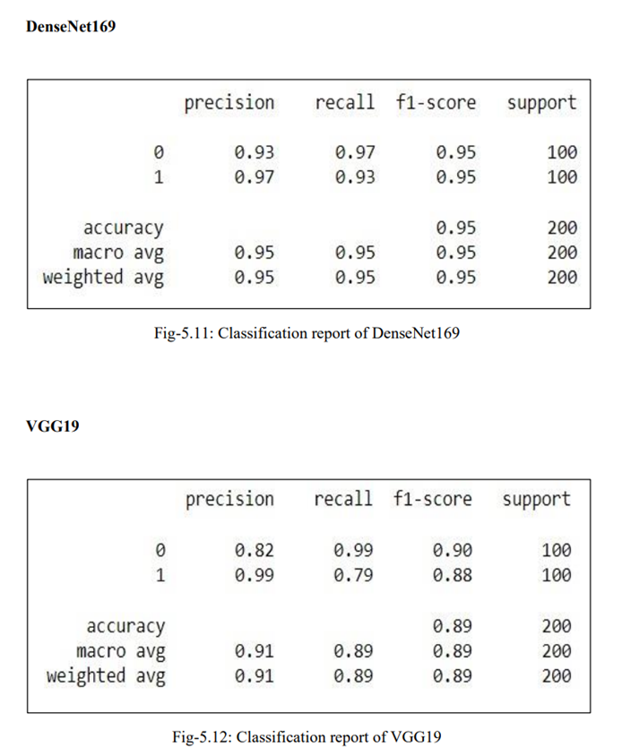

Slide 23
Conclusion :
Alzheimer's disease is the leading cause of dementia. Subtle and spatially complex deformation patterns of hippocampus between patients with AD and healthy control subjects can be detected by machine learning methods. This project determines a prospective solution for detecting the disease at an early stage. The models used in this project have successfully classified the images into the appropriate two classes and indeed provided us with promising results. From the results we observed that the accuracy of DenseNet169 is 95% whereas VGG19’s accuracy is 89%. Showing that DenseNet169’s accuracy is 6% more than the existing VGG19 model. This concludes that DenseNet169 performs better with our dataset than the VGG19 model. Further research is required to ensure that this particular model can be implemented in clinical settings, increasing the health care rate against this specific disease. Knowledge should be spread among people regarding this disease, and they should be encouraged to get themselves examined.

Slide 24
FUTURE SCOPE We can deploy this model onto a website for better practical usage. In the future, this model can also be tested on a larger dataset. • The proposed model can help doctors diagnose Alzheimer's Disease more effectively and can be modified to identify other neurodegenerative diseases more automatically in the future. • It can be built into a proper user interface application so that it is easily accessible to everyone. • It can be transferred as a tool in hospitals so that it helps the patients with Alzheimer’s disease.

Slide 25
THANK YOU

